Slide 1
UNIT-II:
Listening and Speaking skills
Listening skills-Definition of Listening, Listening V/S Hearing,
Process & Types of Listening
Barriers to listening
Significance of listening
Improvising Listening Skills
Speaking skills-Effective speaking,
Presentation Strategies.

Slide 2
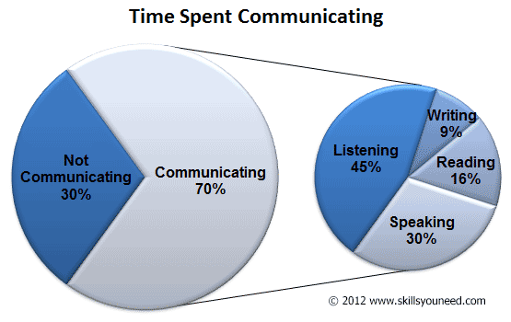
INTRODUCTION TO LISTENING

Slide 3
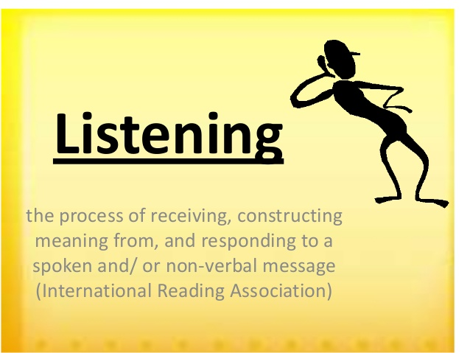

Slide 4
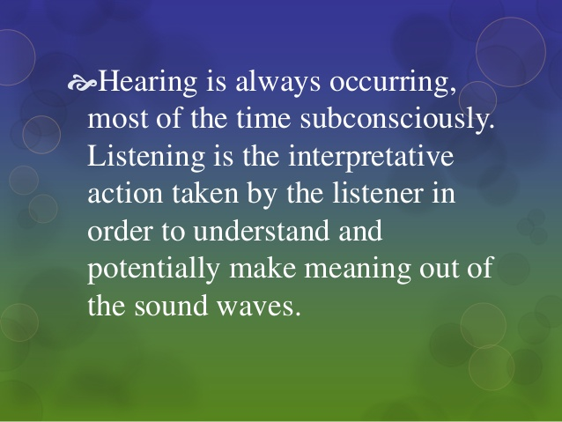

Slide 5
SL. No. | Listening | Hearing
1. | It is a skill and is a conscious act (Psychological) | It is a physical ability and not a conscious act (Physiological)
2. | Listening is intentional and analyzing. | Hearing is random.
3. | Not everyone listens. | Everyone hears unless there is a physical disability.
4. | Systematic process- Making an effort to hear and it involves reception, analysis, interpretation and response. | Random process-Perceiving sound by the ear.
5. | Voluntary | Involuntary
6. | We understand what is being said or heard. | We just hear sound and noise but do not understand much.
7. | Needs focus and care. | Does not need focus.
8. | Listening uses hearing, seeing and sometimes the sense of touch too. | Hearing uses only one of the five senses which is hearing.
9. | Observing the behavior and adding meaning to what the speaker says. | Receiving sound vibrations.
10. | It is an Active process. | It is a Passive process.

Slide 6
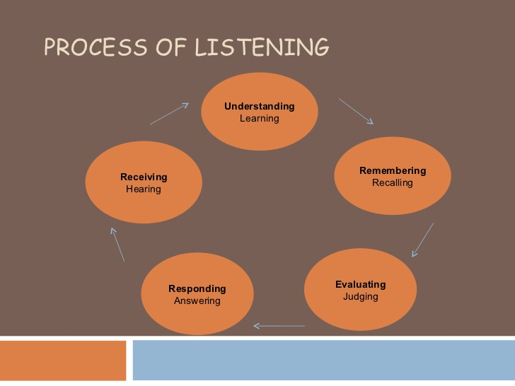

Slide 7
Answer the following questions by choosing correct options giving below.
1. Which is true?
Listening and hearing are remarkably similar.
It is possible to hear without listening.
Listening is physical; hearing is psychological.
It is possible to listen without hearing.
2. Which is true?
a) Listening is a natural process. b) Listening requires effort.
c) All listeners receive the same message. d) All of these are true.
3. Listening is poor when
a)We don't expend the effort. b) We experience message overload.
c) We experience psychological noise. d) All of these are correct.
4. Which of these is not a step in the listening process?
a) Remembering b) Receiving
c) Misinterpreting d) Responding
5. Which of these is the first step in the listening process?
a) Stop talking b) Receiving
c) Interpreting d) Responding

Slide 8
6. is the last step of the listening process.
a) Receiving b) Interpreting
c) Responding d) Stop talking
7. Which of these is not a type of listening?
a) Appreciative listening b) Deep listening
c) Critical listening d) Comprehensive listening
8. Which of these types of listening is followed by skilled listeners?
a) Focused listening b) Critical or Evaluative listening
c) Attentive listening d) Empathetic listening
9. In which of these, the listener puts himself in place of the speaker?
a) Focused listening b) Evaluative listening
c) Attentive listening d) Empathetic listening
10. Generally people speak between 100 and 140 words a minute, but we are capable of understanding speech at words per minute.
a) 600 b)200 c)750 d) 1,500

Slide 9
Answer
1.B. It is possible to hear without listening.
2.B. Listening requires effort.
3.D. All of these are correct.
4.C. Misinterpreting
5.A. Stop talking
6.C. Responding
7.C. Critical listening
8.B. Critical or Evaluative listening
9.D. Empathetic listening
10.A. 600 words

Slide 10
Types of Listening
Active Listening
Passive Listening
1.Discriminative Listening
2. Comprehensive Listening
3.Therapeutic Listening
4. Critical Listening
5. Appreciative Listening.
6.Empathetic Listening.

Slide 11
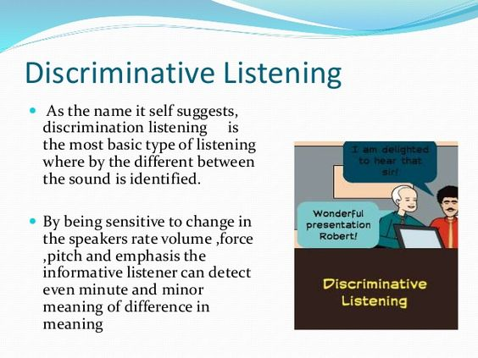

Slide 12
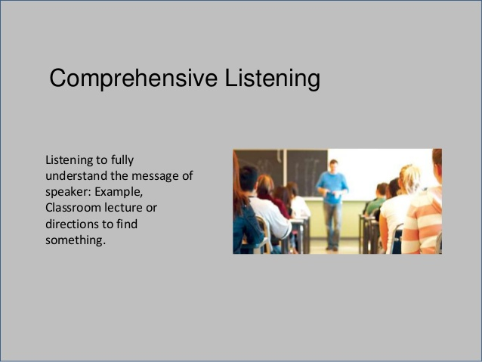

Slide 13
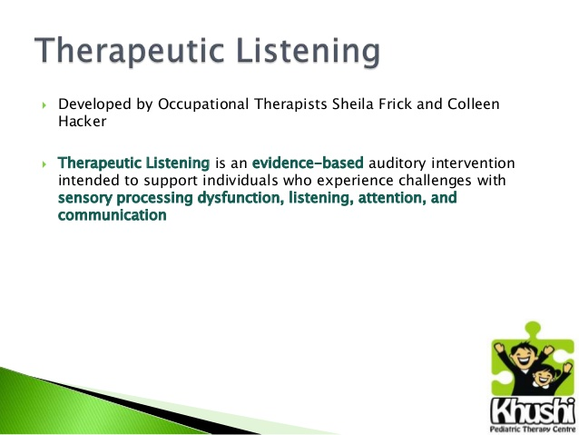
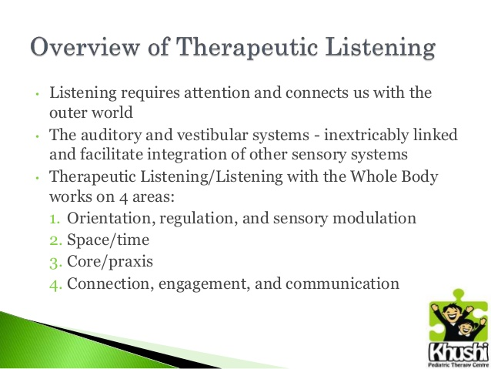
Notes:
Vestibular refers to the balance system of the inner ear. Praxis-theory

Slide 14
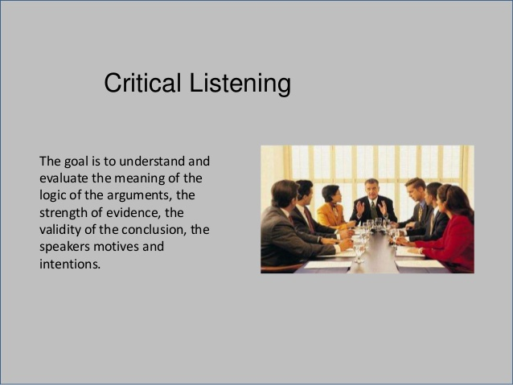

Slide 15
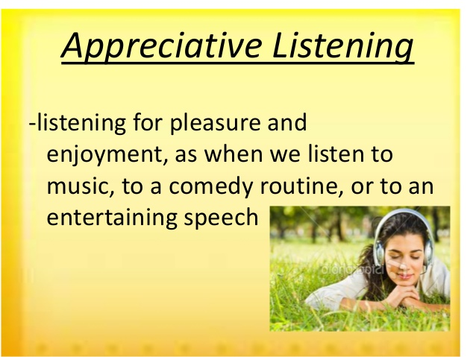

Slide 16
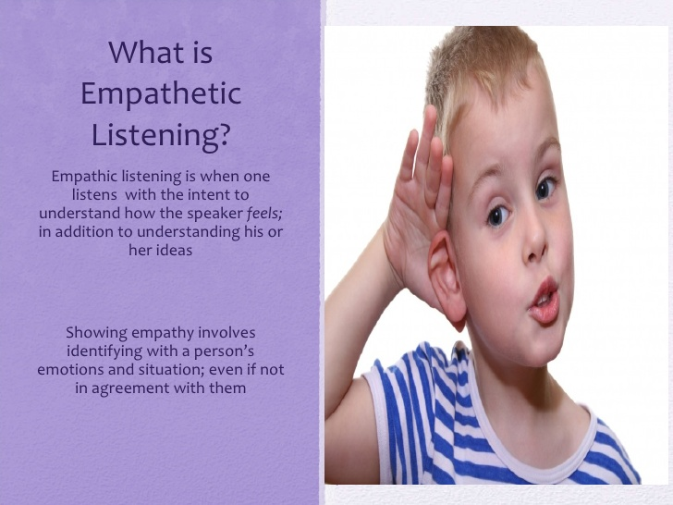

Slide 17
Difference between Active and Passive listening.
Active listening | Passive listening
Is a cognitive purpose. | No cognitive purpose.
Need to comprehension. | Need not necessarily comprehend.
Paraphrasing is required. | No paraphrasing is required.
Questions can be asked. | No questions can be asked.
Exhibit non-verbal responses. | No non-verbal signals.
Notes:
Paraphrasing

Slide 18
Difference between Active and Passive listeners.
ACTIVE LISTENERS: The listener participates fully in the communication process. Listener listens attentively, provide feedback, and strive to understand and remember messages.
They focus on the content as well the manner in which it is delivered. This means that they will take note of the verbal content along with its nonverbal subtexts.
They will not hesitate to seek clarifications, ask leading questions, show their approval by nodding head, and summarize to clearly indicate that they fully follow the speaker.
The active listeners are quiet sensitive towards the feelings of others; they understand the mood of the audience.
They show empathy and make the audience or the other person cared for. Once the audience gets the feeling that they are being cared for, they will devote themselves fully to the communication process.

Slide 19
PASSIVE LISTENERS: The listener does not actively participate in interactions. They think they can absorb information even when they do not contribute to the interaction. They place the responsibility for successful communication on the speaker.
Passive listeners exhibit exactly the opposite behavioristic traits of active listeners.
They pay attention only to partial message and lack of sensitivity to the nuances, inner meanings, nonverbal subtexts involved in communication.
They allow someone to speak, without interrupting or seeking clarifications.
They do not make notes, nod their head in approval, maintain eye contact and keep themselves idle.
Passive listeners who accept not evaluate.
Passive listener who suspends judgment and just listens.

Slide 20
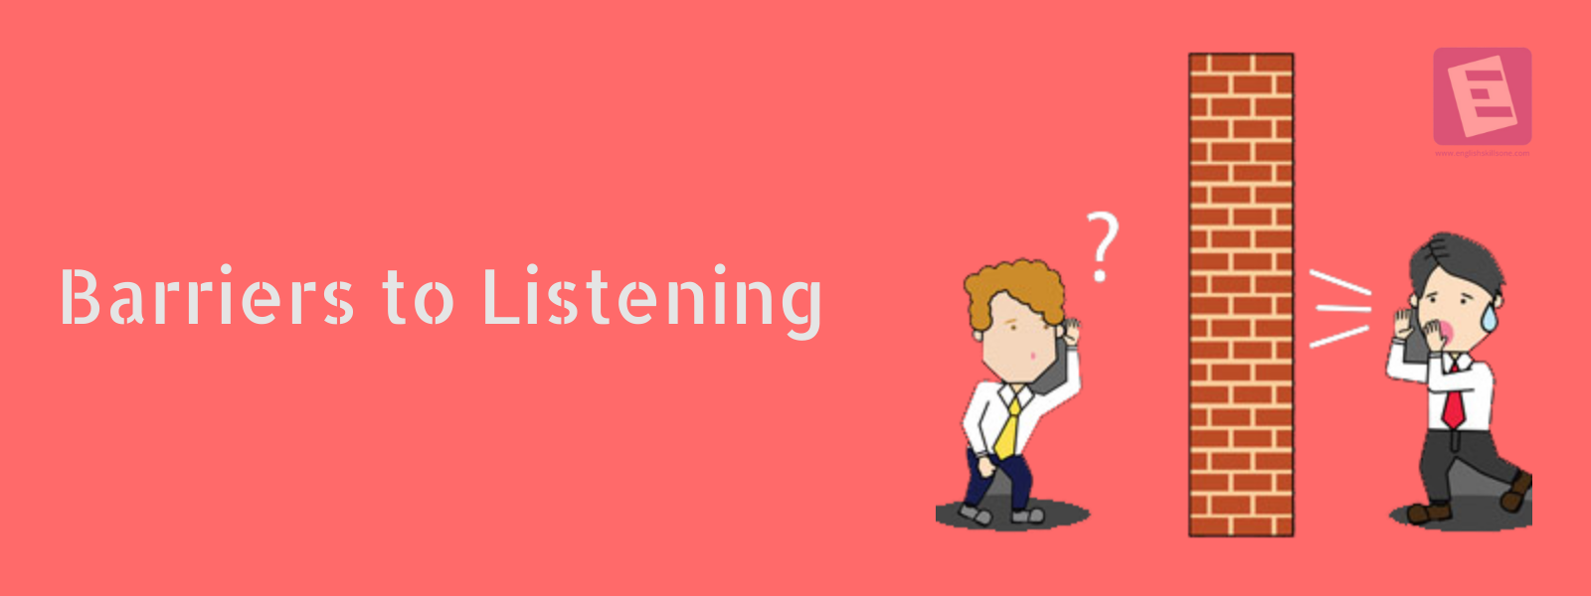
BARRIERS TO LISTENING
1.Excessive Talking
2.Prejudice
3.Distractions
4.Misunderstanding
5.Interrupting
6.Fake Attention
7.Bringing in Emotions
8.Noise
9.Fear
10.Expecting others to share your personal
Beliefs and Values

Slide 21
Answer the following questions by choosing correct options giving below.
1. Which of these should be avoided for effective listening?
a) Pre-listening analysis b) Listening to structured talks
c) Team listening d) Predicting
2. In which of these does the listener pick up special features of the speech?
a) Listening in conversational interaction b) Listening to structured talks
c) Predicting d) Team listening
3. A well organized talk is a talk.
a) Short b) long
c) Random d) structured
4 Which of these should be avoided in pre-listening analysis?
a) Mental discipline b) Concentration
c) Prejudices d) Patience
5. Predicting’ is the technique to forecast what the speaker will say.
a) True b) False

Slide 22
6. In which of these, should the listener be able to make connections between different segments of the speech?
a) Listening to structured talks b) Links between parts of the speech
c) Team listening d) Predicting
7. Which of these is based of effective listening?
a) Note taking b) Notice writing
c) Letter writing d) Predicting
8.Which of these should be avoided while note taking?
a) Concentration b) Evaluation
c) Listening d) Using phrases
9. Which of these is not a type of text for reading?
a) Reference material b) Chats
c) Scientific text d) Technical text
10. Which of these is not a deterrent to the listening process?
a) Lack of interest c) Confidence
b) Ego d) Fear

Slide 23
Answer
1.D. Predicting
2.A. Listening in conversational interaction
3.D. structured
4.C. Prejudices
5.A. True
6.B. Links between parts of the speech
7.A. Note taking
8.B. Evaluation
9.B. Chats
10.C. Confidence

Slide 24
Significance of listening
Listening skills help us to understand and follow instructions.
It minimizes the risk of error and deviation at work or school.
It will help us to settle quickly into the working environment.
Pay attention and absorb information during speeches.
Learn faster and easily during on-the-job training.
Enjoy an improved brain absorption rate.
Enjoy smoother and faster revision of lesson notes.

Slide 25
Improvising Listening Skills
Hearing or Receiving
Understanding (Comprehension)
Remembering
Evaluating
Feedback
Slow our listening down
Pay attention

Slide 26
Answer the following questions by choosing correct options giving below.
1. Which of these is not a barrier to listening?
a) Physical barrier b) Cultural barrier
c) Linguistic barrier d) Written barrier
2. Which is the main barrier to listening?
a) Physical barrier b) Linguistic barrier
c) Cultural barrier d) Physiological barrier
3. Which of these is not a psychological barrier?
a) Fear b) Different perception
c) Gel effect d) Halo effect
4. Which of these is based on faith?
a) Fear b) Halo effect
c) Emotions d) Different perception
5. When people take extreme positions what is it called?
a) Fear b) Halo effect
c) Emotions d) Polarization

Slide 27
6. Which of these occur because of difference in language?
a) Physical barriers b) Linguistic barriers
c) Cultural barriers d) Speech decoding
7.Barriers which are caused because of different meanings of a word to different people is called
a) Different perception b) semantic distortions
c) Physical barriers d) cultural barriers
8. Which of these barriers occur when people belong to different religious backgrounds?
a) Physical barriers b) Linguistic barriers
c) Cultural barriers d) Speech decoding
9. Who among these bow down to greet?
a) Japanese b) Americans
c) Indians d) French
10. Which of these is not a step in speech decoding?
a) Listening b) Writing
c) Translating d) Understanding

Slide 28
Answer
1.D. Written barrier
2.A. Physical barrier
3.C. Gel effect
4.B. Halo effect
5.D. Polarization
6.B. Linguistic barriers
7.B. semantic distortions
8.C. Cultural barriers
9.A. Japanese
10.B. Writing

Slide 29


Slide 30
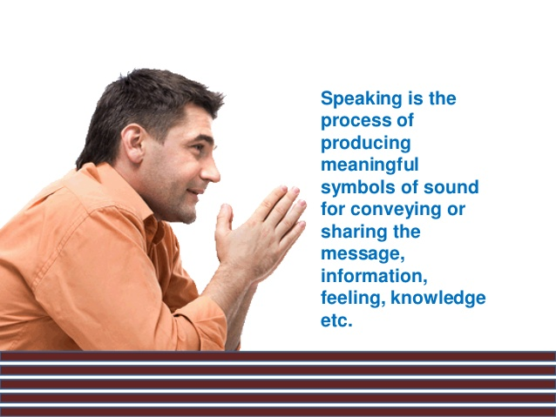
SPEAKING SKILLS-Effective speaking
Art of speaking: Speaking is an art but also a skill that may be mastered. Speaking is about speaking logically and clearly but also about emotion. Speaking skills are not restricted to the speaker of any language or social or ethnic group.

Slide 31
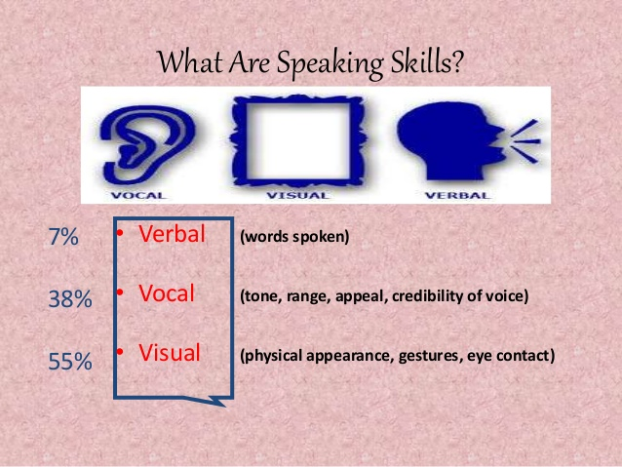

Slide 32
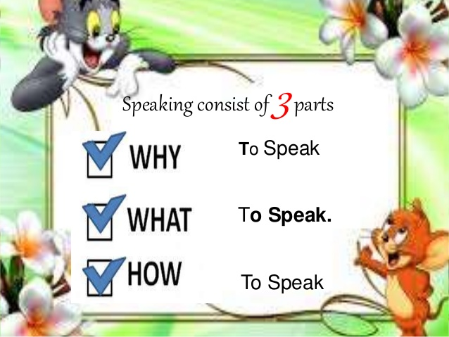

Slide 33
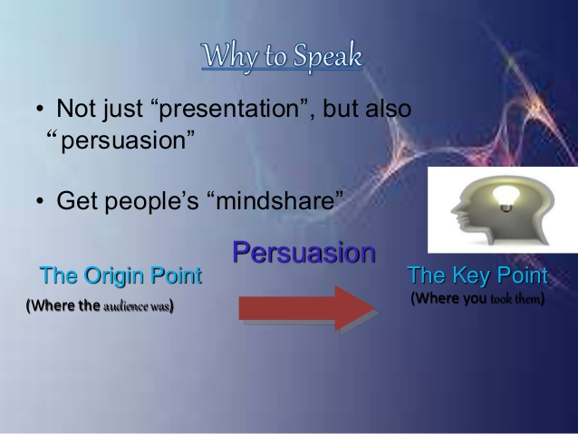
Notes:
Persuasion

Slide 34
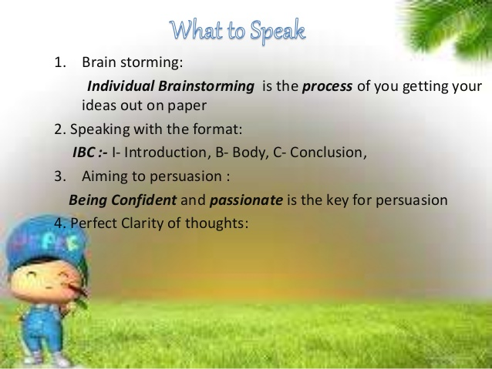

Slide 35
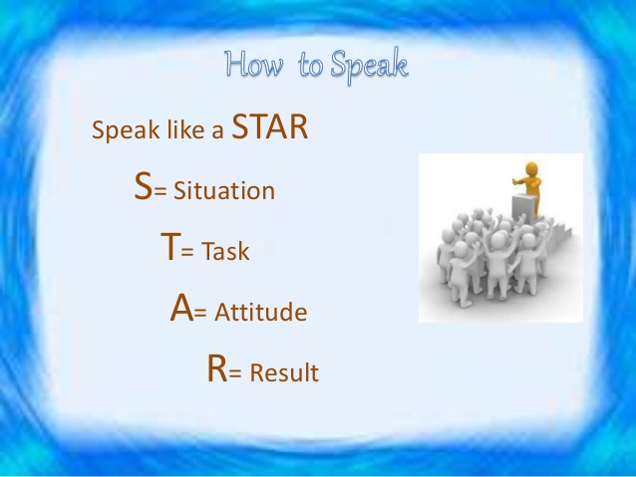

Slide 36
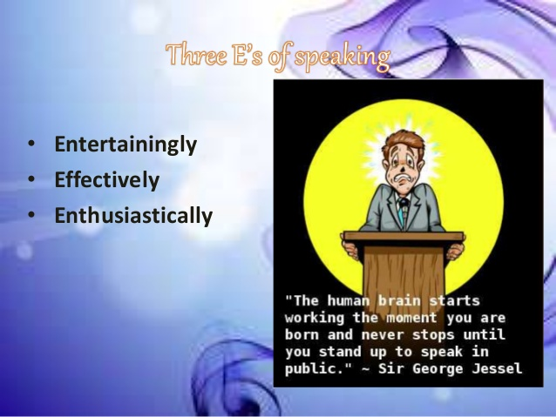
33

Slide 37
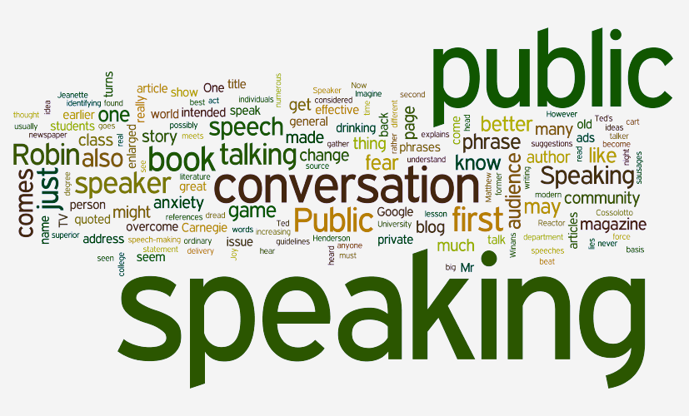
Key elements of Effective speaking
1.Confidence
2.Clarity
3. Fluency
4. Vocal production
5. Body language
6. Shorter sentences are easier to process and understand.
7. Simpler words are also easier to understand.
8.Use of nonverbal communication especially body language makes speaking effective.
9. Effective use of voice modulation-volume to be heard, Clarity- to be understood, Variety- adds interest.
10. Effective usage of words is required.

Slide 38

Presentation Strategies
What is Presentation?
A presentation is a technique or a method of communicating ideas and information to a group of people. It carries the speaker’s personality better and allows interaction between all the participation.

Slide 39
Objectives of Presentation:
Presentation will provide information.
It is a teaching skill.
Presentation used for selling a product, service or strategy.
To obtaining a decision presentation helps.
Presentation helps to solving a problem.

Slide 40
Components of effective Presentation
Defining purpose
Analysis of audience and location
Organizing contents-
1. Introduction 2. Body 3. Conclusion (iv) Preparing an outline of the presentation (v) Visual aids (vi) Nuances of delivery-
Extemporaneous, Manuscript (vii) Body language and effective presentation
Notes:
Nuances

Slide 41
Answer the following questions by choosing correct options giving below.
1. Body language can make or break a speech.
a) True b) False
2. Which of these is the study and classification of speech sounds?
a) Gestures b) Speech style
c) Phonetics d) Spoof
3. Which of these is not an element of the speaking technique?
a) Voice quality b) Word stress
c) Appearance d) correct tones
4. Which of these means giving emphasis to a syllable?
a) Voice quality b) Word stress
c) Tone d) Message
5.Which of these factors is not involved in the determination of correct tone?
a) Pitch b) Dressing style
c) Quality d) Strength

Slide 42
6. Which of these is not a type of tone?
a) Urgent tone b) Serious tone
c) Restrained tone d) Jumping tone
7. Which of these tones represent thoughtfulness?
a) Serious tone b) Urgent tone
c) Happy tone d) Outraged tone
8. Which of these tones is an unemotional tone?
a) Happy tone b) Outraged tone
c) Restrained tone d) Humorous tone
9. tone is used when speaker wants to bring about a good impression of her life.
a) Outraged b) Reflective
c) Restrained d) Urgent
10. Which of these tones is used to express contentment?
a) Serious tone b) Happy tone
c) Outraged tone d) Urgent tone

Slide 43
Answer
1.A. True
2.C. Phonetics
3.C. Appearance
4.B. Word stress
5.B. Dressing style
6.D. Jumping tone
7.A. Serious tone
8.C. Restrained tone
9.B. Reflective
10.B. Happy tone

